Slide 1

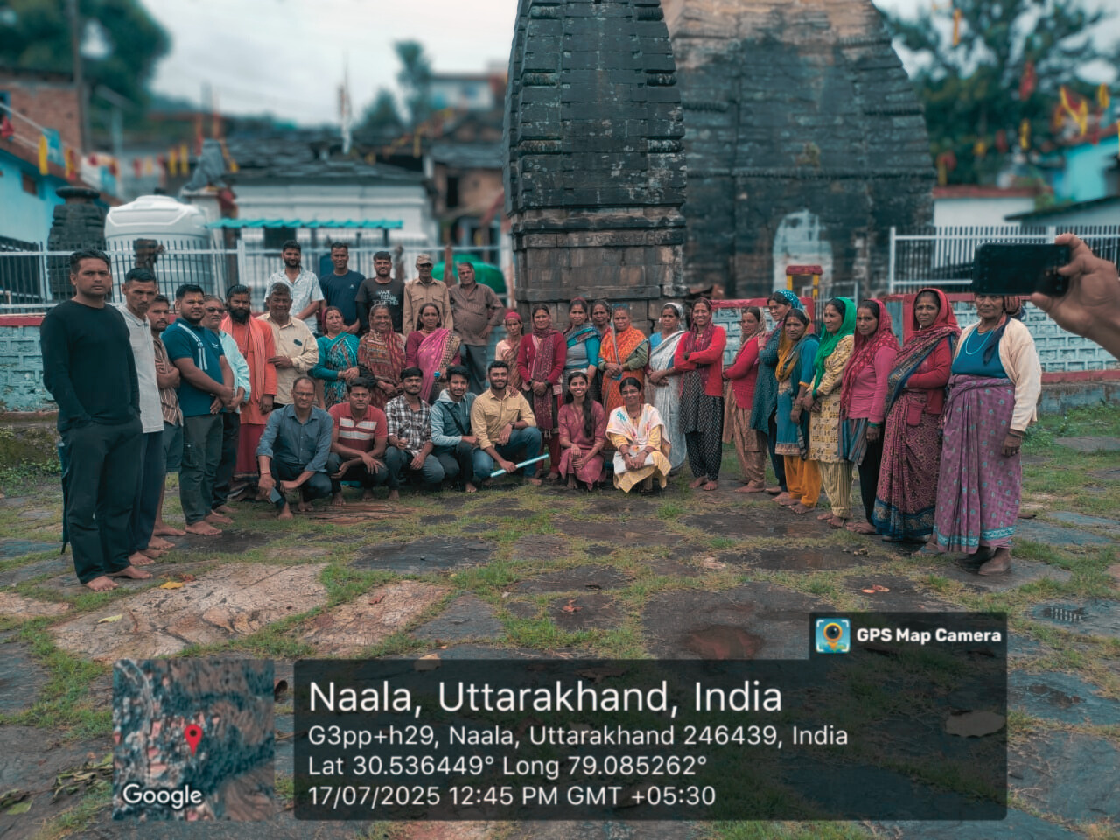

Live in Labs II
Final Presentation
TEAM : ABHYUDAYA
Members :
Aditya Bhatt B – AM.EN.U4EEE23006
N Vivekananda – AM.EN.U4ECE22028
Krishnapriya V B – AM.EN.U4ECE22052
Vaishnav B Ajith – AM.EN.U4ELC23052
1

Slide 2

Introduction
Location: Naala is a small hilly village in Uttarakhand with around 30 households divided between upper and lower regions.
Livelihood: Most villagers depend on agriculture and daily wage work for their income.
Water Source: The main water sources are a natural spring (dhara) and a piped supply system connected to a community tank.
Problem: The piped water is often contaminated, with a foul smell and visible particles, making it unsafe for drinking.
Health Impact: Seasonal outbreaks of typhoid and diarrhea are commonly reported due to poor water quality.
Project Goal: To implement a sustainable water filtration system, ensure safe access for all households, and promote hygiene awareness through community participation.
2

Slide 3
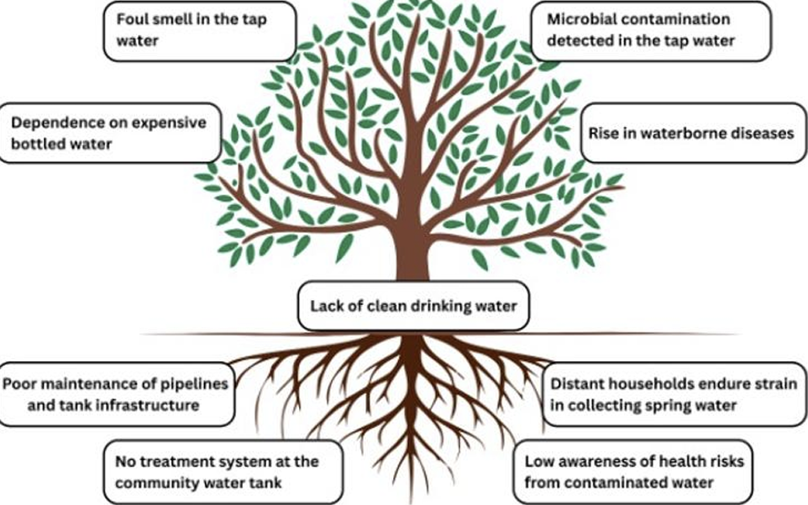
Problem Tree
3

Slide 4
Problem Context
Contaminated Piped Water:
The village’s main piped water supply is often unsafe due to unclean storage tanks, pipeline leakages, and foul smell.
Dependence on Dhara (Natural Spring):
Many households still rely on the dhara located downhill, but collecting water is physically tiring.
Health Impacts:
Seasonal outbreaks of typhoid and diarrhoea are frequently reported and verified by PHC doctor
4

Slide 5
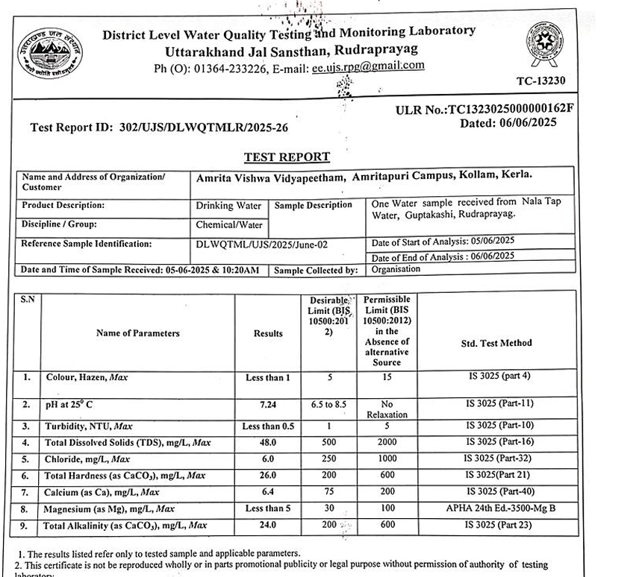
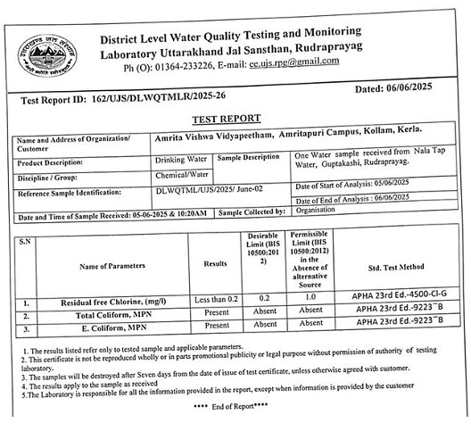
Water Quality Test Results
5

Slide 6
Water Quality Test Results
Presence of E. coli bacteria
Presence of total coliform bacteria
No physical or chemical contamination detected
The detection of coliforms in storage tanks indicated exposure to sources of microbial pollution, making the water unsafe for direct consumption
6

Slide 7
Problem Analysis
Direct causes:
Poorly maintained storage tanks
Leakages in pipelines
Absence of any treatment or filtration system
Indirect causes:
Low awareness about safe water practices
Reliance on traditional beliefs in the purity of spring water
Irregular maintenance schedules
Limited accountability for upkeep
7

Slide 8
Identified Solution
After reviewing community needs and water test results, the Jivamritam filtration system was identified as the most suitable solution.
Reason for Selection:
Effective against biological contamination (main issue in Naala).
Culturally acceptable and easy for local management.
Low-maintenance and cost-effective compared to RO systems.
Filtration Design (3-Stage Process):
Pre-sediment filter – removes large particles and debris.
Micron filter – eliminates finer dust and suspended impurities.
UV filter – kills bacteria, viruses, and biological contaminants.
System Capacity:
Storage tank: 1000 litres (sourced from dhara).
Daily refill cycle based on community water demand.
8

Slide 9
Problem Objectives
Ensure Safe and Reliable Drinking Water
Implement a community-level filtration system to provide clean, odor-free, and biologically safe water for all households.
Promote Equitable Access for All Groups
Design the system layout and pipeline structure to ensure inclusive access, addressing social sensitivities and ensuring fairness.
Increase Awareness on Water Hygiene
Conduct awareness sessions, install educational posters, and engage children and women to encourage safe water practices.
Build Local Capacity and Ownership
Form and train a Water Management Committee responsible for daily operation, maintenance, and long-term monitoring.
9

Slide 10
Methodology
The project followed a Human-Centered Design (HCD) approach, ensuring that community members were involved at every stage
Participatory Co-Design Tools Used:
Focus Group Discussions: To understand challenges, expectations, and concerns from different community groups.
Poster Cards & Storytelling: To communicate ideas visually and collect villagers’ preferences for awareness content.
Group Sketching: To visualize how the surroundings of the filter and pipelines should look.
Timeline Mapping: To co-decide filter operating hours and maintenance schedules.
Demonstrations: To explain filter functionality and promote understanding of its usage and upkeep.
10

Slide 11
Co-design Findings
Site selection
Pre-identified potential sites were evaluated for accessibility, safety, cleanliness, water source proximity, and electricity availability.
We used the poster card tool to present pre-identified filter sites in an engaging, visual format, making it easy for all community members to participate in the selection process.
Site Selected : Maa Tripura Sundari Temple was chosen as the installation site because it is centrally located, easily accessible, and already had an existing water connection, ensuring convenience for all households.
The area provides a clean, flat, and secure terrain, free from animal intrusion, making it ideal for safe installation, maintenance
11

Slide 12
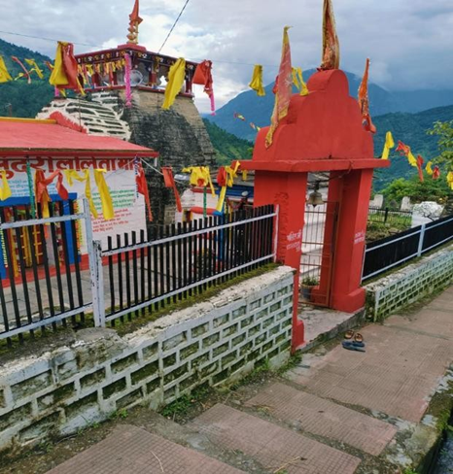
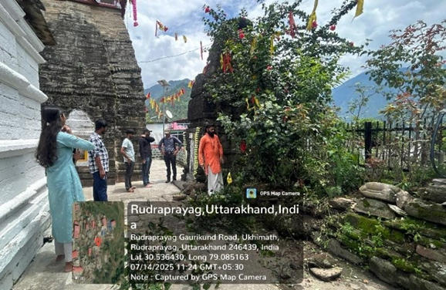
Co-design Findings
Maa Tripura Sundari temple
Site selected for Filter
12

Slide 13
Co-design Findings
Formation of Water Management Committee
A six-member Water Management Committee was established to ensure the smooth daily operation, maintenance, and monitoring of the filtration system.
The committee includes three women and three men.
The team maintains a balanced representation of three women and three men, encouraging shared responsibility, inclusivity, and community ownership.
Members were given hands-on training by the Jivamritham team to operate, clean, and maintain the filtration system, ensuring local capacity building.
13

Slide 14
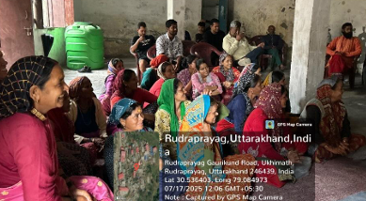
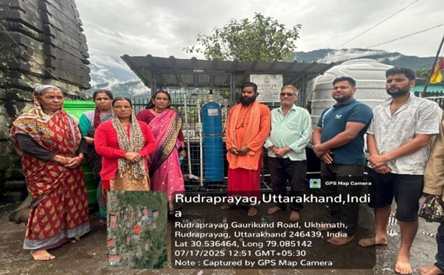
Community Gathering
Water Committee Members
14

Slide 15
Timeline Mapping
A clock chart was placed in a common area, and all villagers were gathered and invited to mark their preferred times for collecting filtered water.
Group discussion followed, where everyone explained their choices, helping everyone agree on the most suitable hours to run the filtration unit.
15

Slide 16
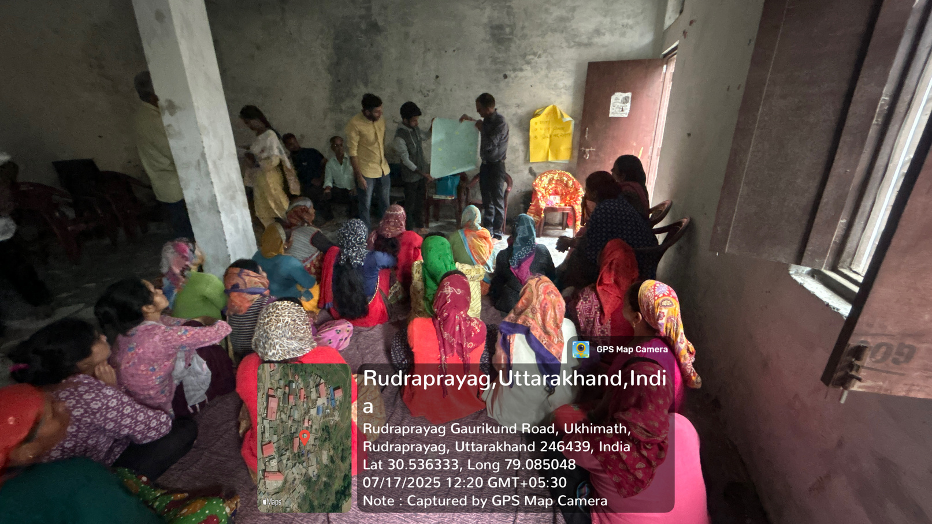
Co-design Findings
Filter Timings
Using a timeline mapping activity, villagers collectively discussed and finalized the daily operating hours for the filtration system.
The agreed timings - 10:00 -11:00 AM and 4:00–5:00 PM were chosen to match the community’s peak water usage periods and ensure convenience for all households.
The approach also helped in efficient water management, reducing crowding and ensuring a steady, organized distribution.
16

Slide 17
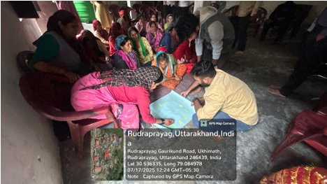
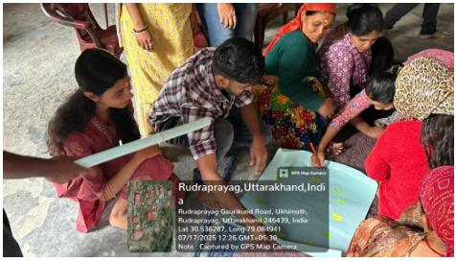
Timeline Mapping
Collaborative Planning
Community Voting
17

Slide 18
Group Discussions
Group discussions were held at convenient village locations and actively involved all key community groups, with facilitators making sure that everyone’s opinions and concerns were equally heard.
Each session focused on specific topics such as site suitability, cultural concerns, and involved selecting Water Management Committee members and a caretaker with roles and responsibilities assigned in agreement with all villagers.
18

Slide 19
Co-design Findings
Awareness and Aesthetic Design Inputs
Women from both caste groups actively participated in the group sketching sessions, sharing their ideas and preferences for poster designs, slogans, and wall visuals around the filtration site.
The activity was carried out through group sketching, allowing participants to visually express how they wanted the surroundings of the water collection area to look.
The women suggested that the posters be laminated instead of wall paintings to ensure durability, easy cleaning, and protection from weather.
Based on their collective input, three posters were finalized incorporating community-selected colors, slogans, and imagery.
19

Slide 20
Co-design Findings
Inclusive Access
During community discussions, it was identified that lower caste households are not permitted to enter the temple premises, where the main filtration unit is installed.
To ensure equal and dignified access for all villagers, the community requested a separate water outlet to be placed outside the temple boundary.
In response, the system was designed with a dual-tap arrangement - one tap located inside the temple compound and another outside, both directly connected to the same filtration unit.
20

Slide 21
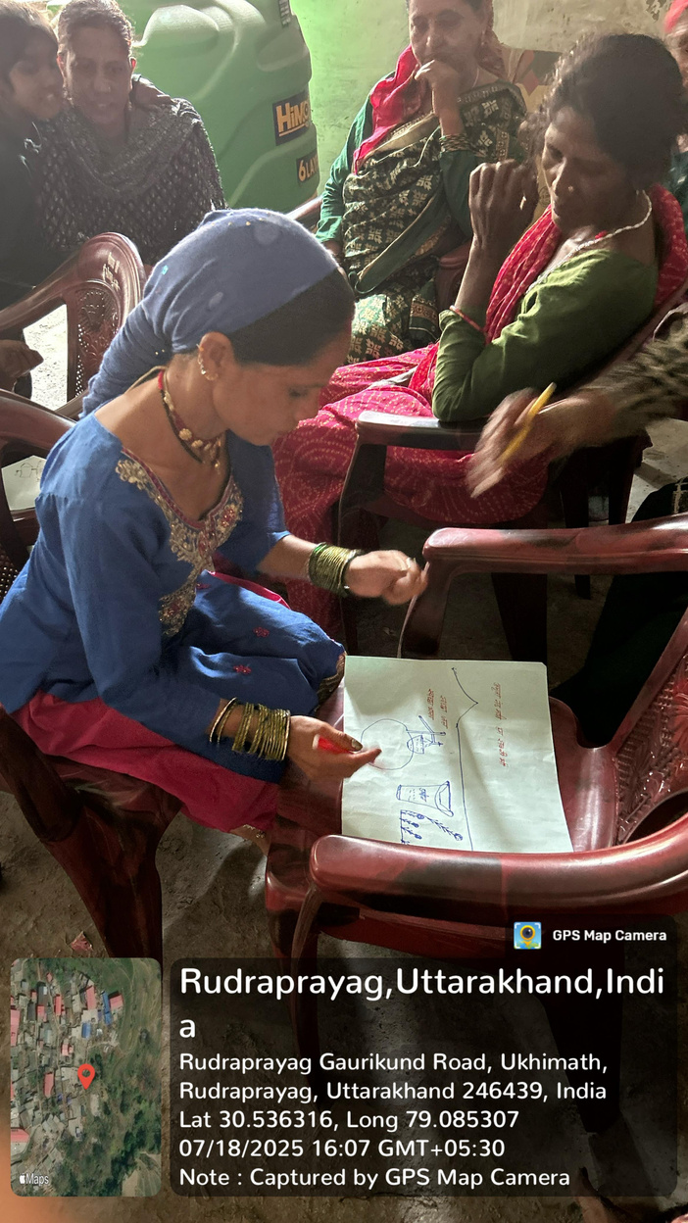
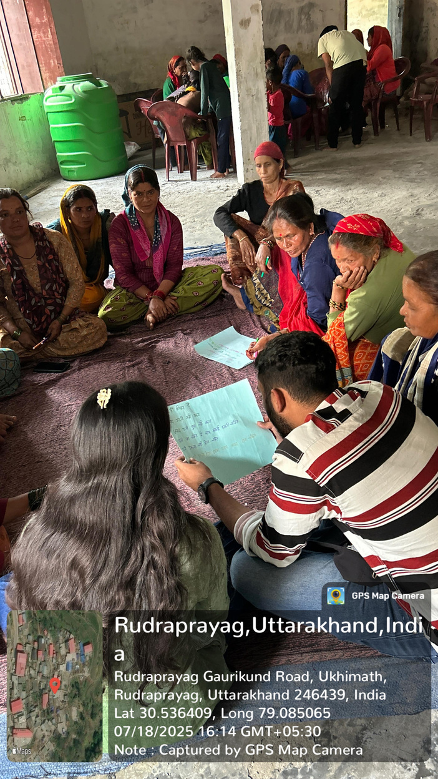
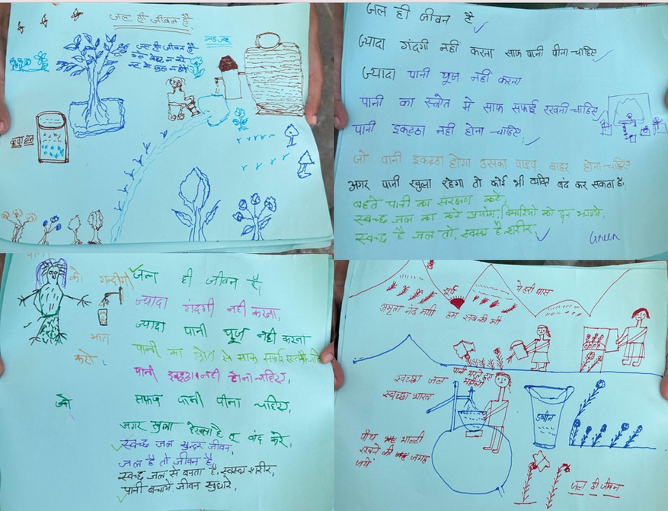
Group Sketching
Group Sketching
Design Ideas
21

Slide 22
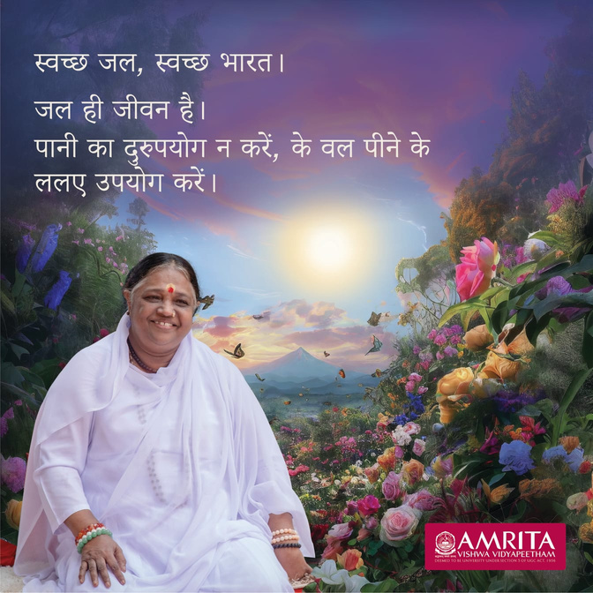
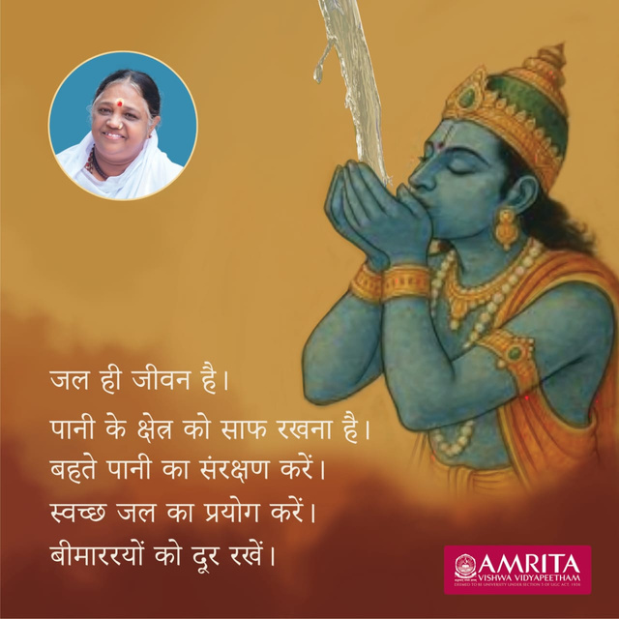
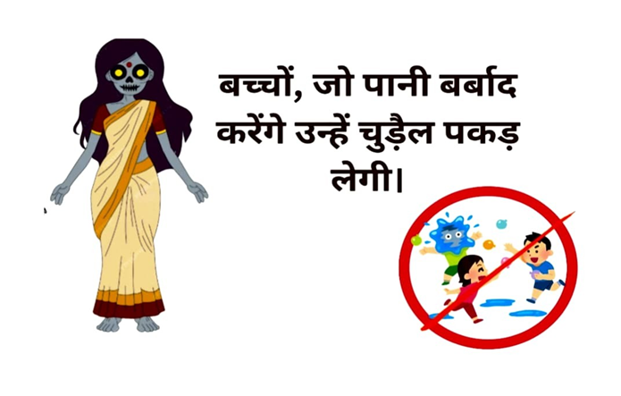
Group Sketching
Design posters created from group sketching inputs.
Lower-caste group
Upper-caste group
22

Slide 23
Awareness/ Story Telling
For Villagers
Through poster cards and storytelling, villagers recognized that clear-appearing water isn't always safe and expressed willingness to adopt safer practices like filtration and boiling.
For Children
Interactive sessions were held at the tuition center.
Used animated videos and visual demonstrations.
Covered diseases caused by unsafe water, proper hygiene practices, and benefits of using the new filtration system.
23

Slide 24
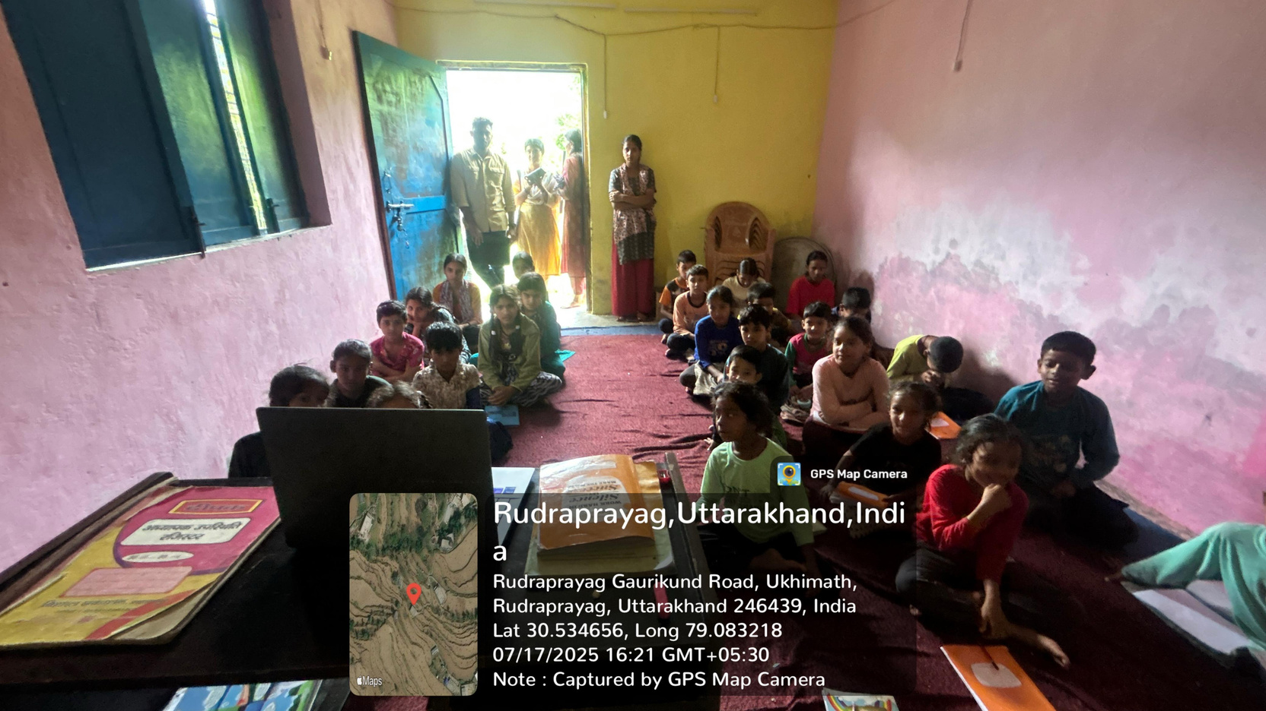
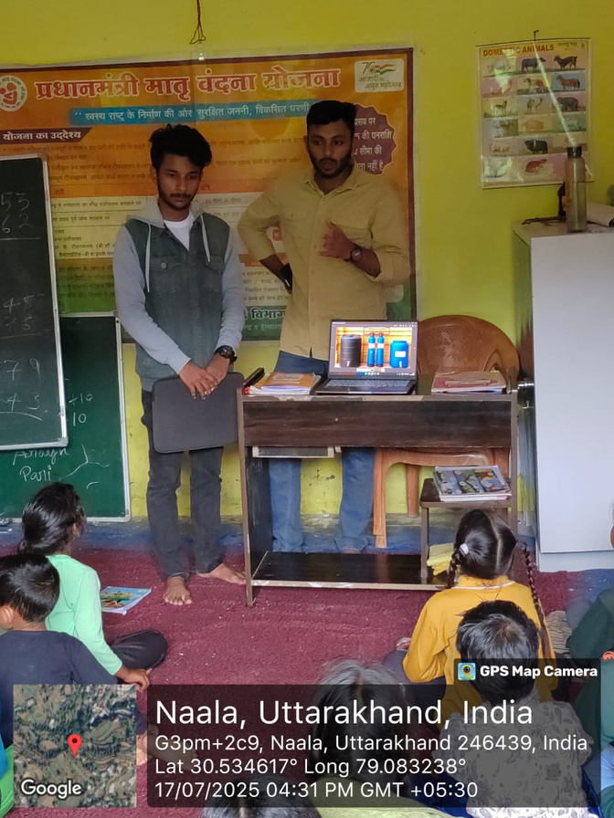
Awareness/ Story Telling
Interactive storytelling
Awareness talk
24

Slide 25
Demonstration
Bottle Filter Demonstration: A simple prototype using gravel, sand, and charcoal layers was shown on inauguration day to visibly explain filtration. This helped villagers see how impurities are removed and built trust in clean water use.
Jivamritam Filtration System: The actual community water filtration system was demonstrated with hands-on training for the water management committee. They practiced operating, regulating flow, cleaning, and safety steps under supervision. This empowered them to manage the system independently, ensuring sustainability and community ownership.
25

Slide 26
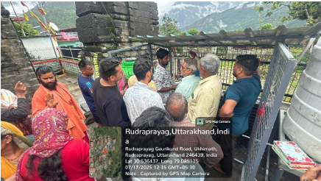
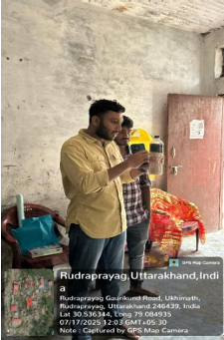
Demonstration
Hands-on Demonstration
Bottle Filter Demonstration
26

Slide 27
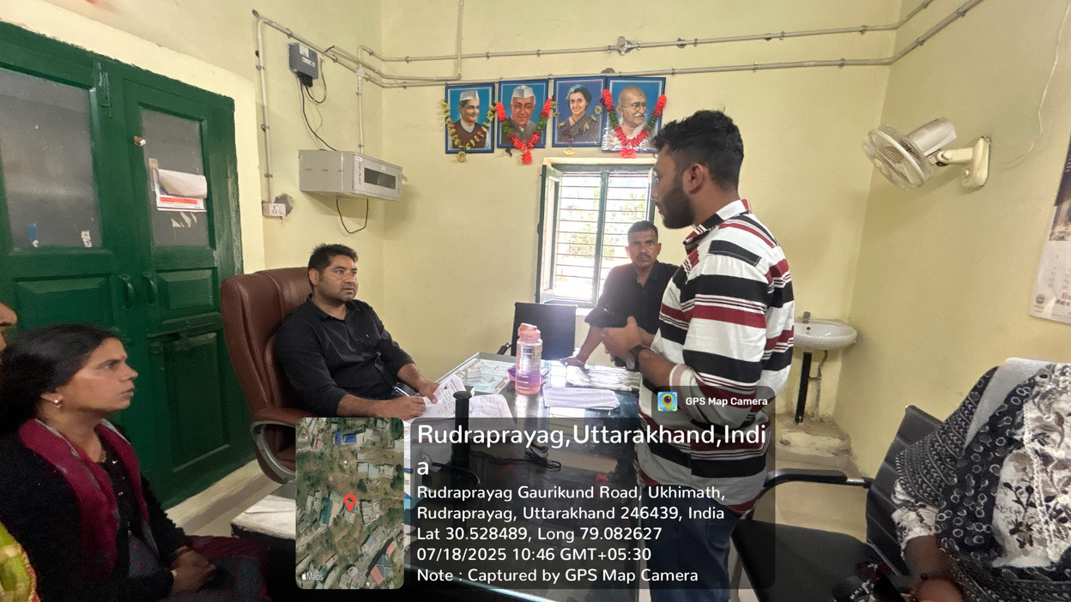
PHC Collaboration
The PHC doctor was requested to track and record waterborne diseases such as typhoid, diarrhoea, and cholera in the village.
The doctor was also asked to encourage villagers to drink water only from the filtration unit, reinforcing safe hygiene practices.
According to the doctor, it would take approximately one year to observe a clear and measurable reduction in waterborne disease cases.
27

Slide 28
Implementation
The Jivamritam water filtration unit was successfully installed at the selected temple site.
The system consists of two tanks - one for raw water storage and another for filtered water output, ensuring continuous supply and storage management.
The filter design includes a three-stage purification system:
Pre-sediment filter – removes larger particles and suspended impurities.
Micron Filter - mechanical filter that removes particles
UV filtration unit – disinfects water by killing bacteria and pathogens.
The total filtration capacity is approximately 1,000 litres per day, adequate for meeting the daily water needs of all 70 households in the village.
28

Slide 29
Implementation
The floor slab around the filter was concreted to enhance stability and maintain hygiene.
A raised platform was built to hold the water tank securely and prevent contamination.
The pipeline for the lower community was relocated to a new, easily accessible area based on their preference, ensuring equal access.
Small concrete platforms were constructed near the outlets for villagers to conveniently place water buckets during collection.
The surroundings were cleaned and leveled, and an awareness wall was prepared for educational posters.
Three awareness posters were designed and placed — two (91 × 91 cm) for the upper region outlets and one (73 × 86 cm) for the lower region — featuring slogans and visuals on hygiene, safe water use, and filter maintenance.
29

Slide 30
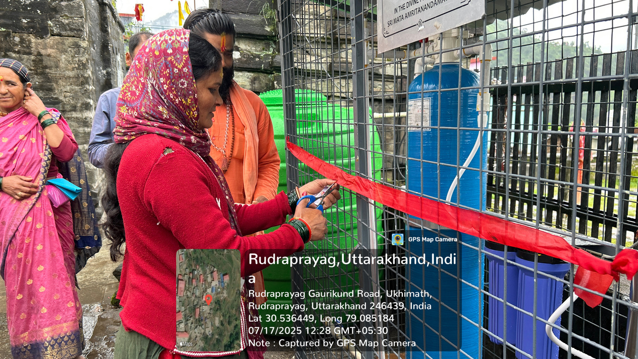
Inauguration of Filter
The Jivamritham water filtration system was inaugurated on 18 July 2025 in the presence of: Panchayat members, ward representative, Water Management Committee, villagers, Jivamritham team, and Live-in-Labs student team.
During the inauguration, the team conducted live demonstrations showing how the filtration system operates, explaining each stage of the purification process and safety precautions.
Villagers were invited to observe and operate the unit themselves, helping them gain confidence in handling and maintaining the system.
30

Slide 31
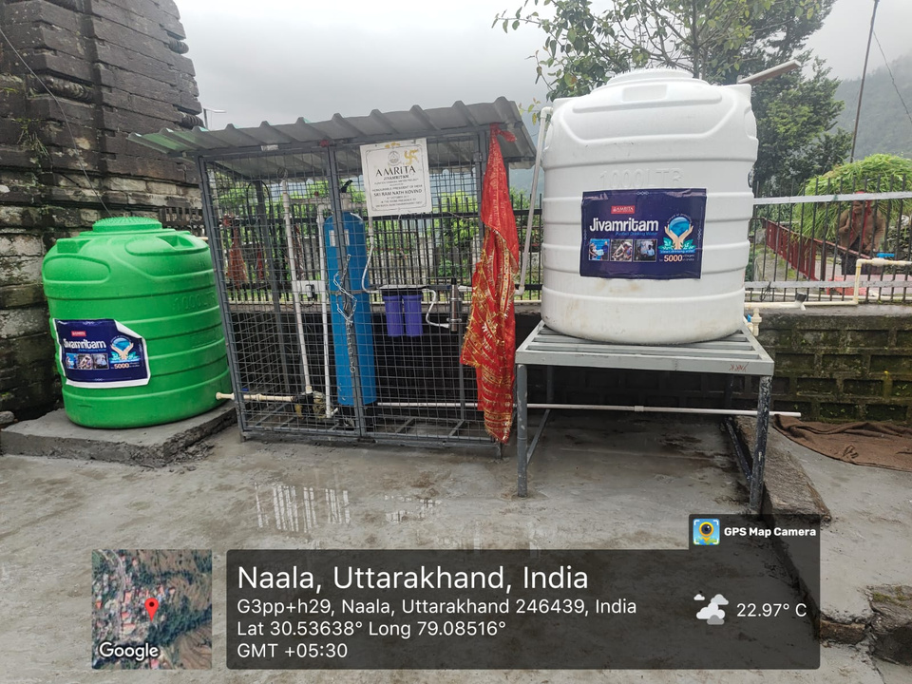
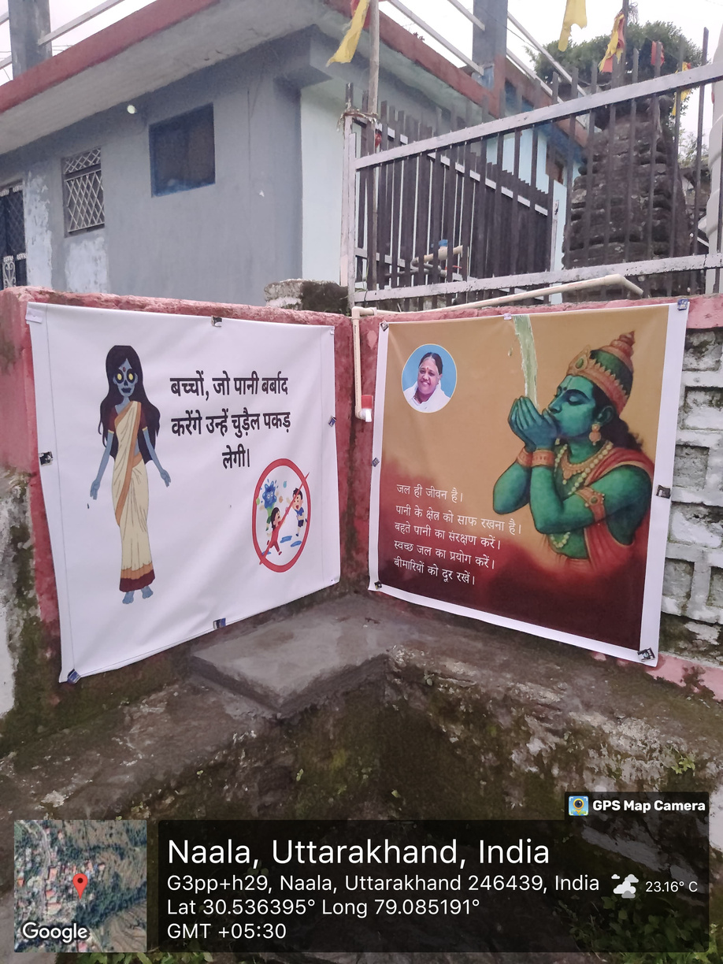
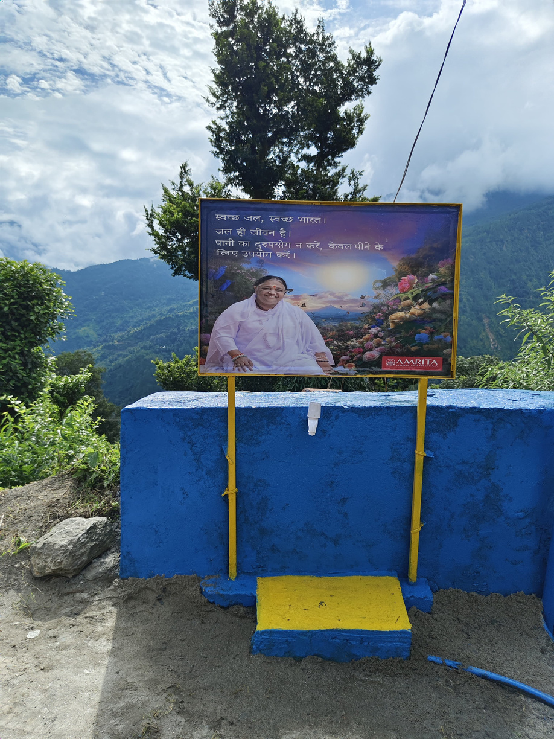
Implementation
The filter unit was tested successfully, demonstrating clear, odor-free water and consistent flow during the inauguration event.
Filtration system
water collecting point
31

Slide 32
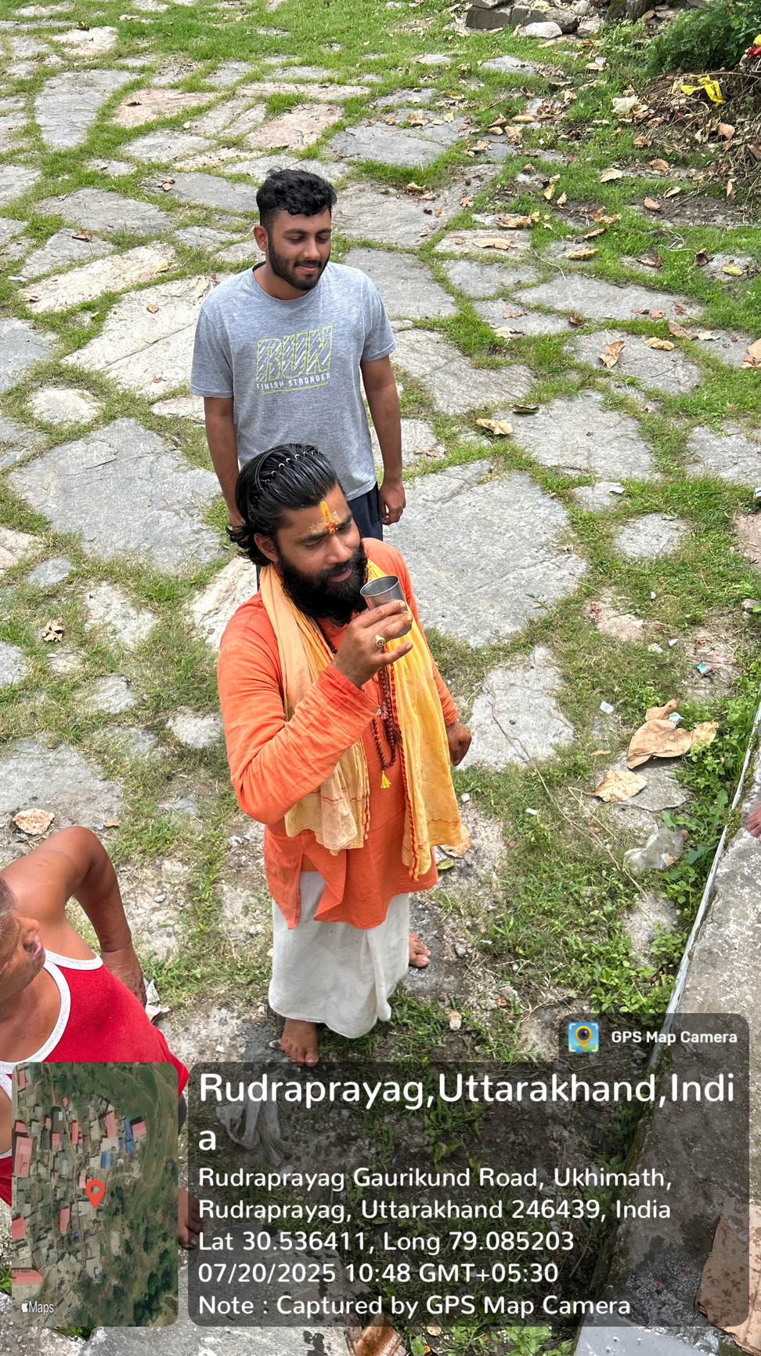
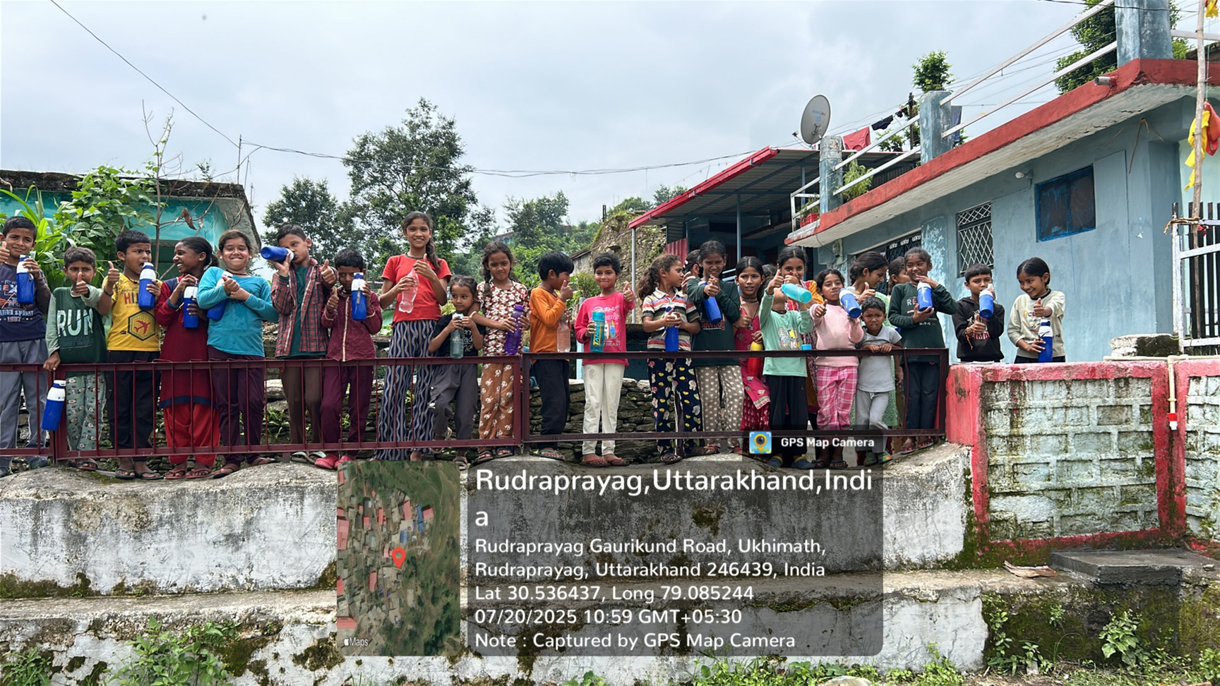
Implementation
32

Slide 33
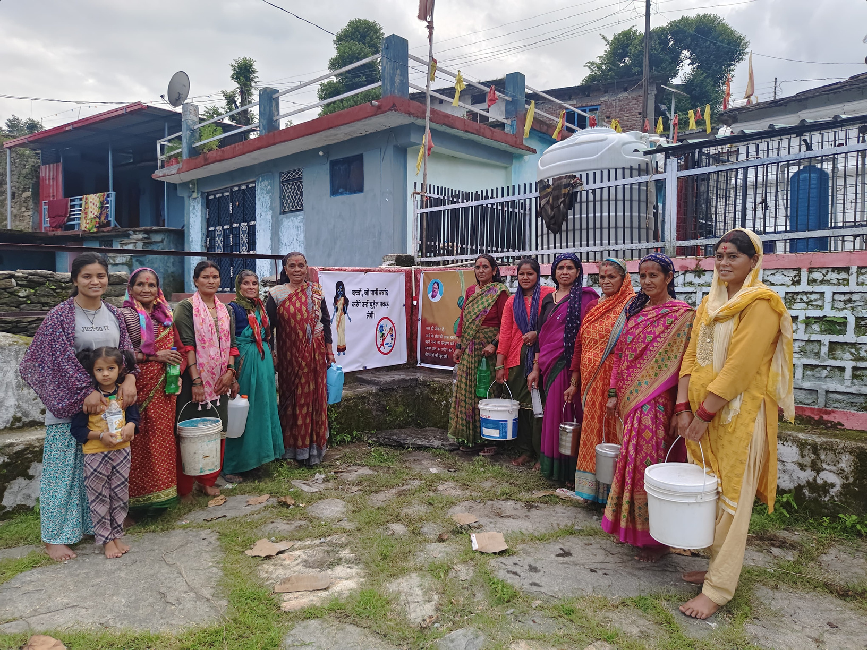
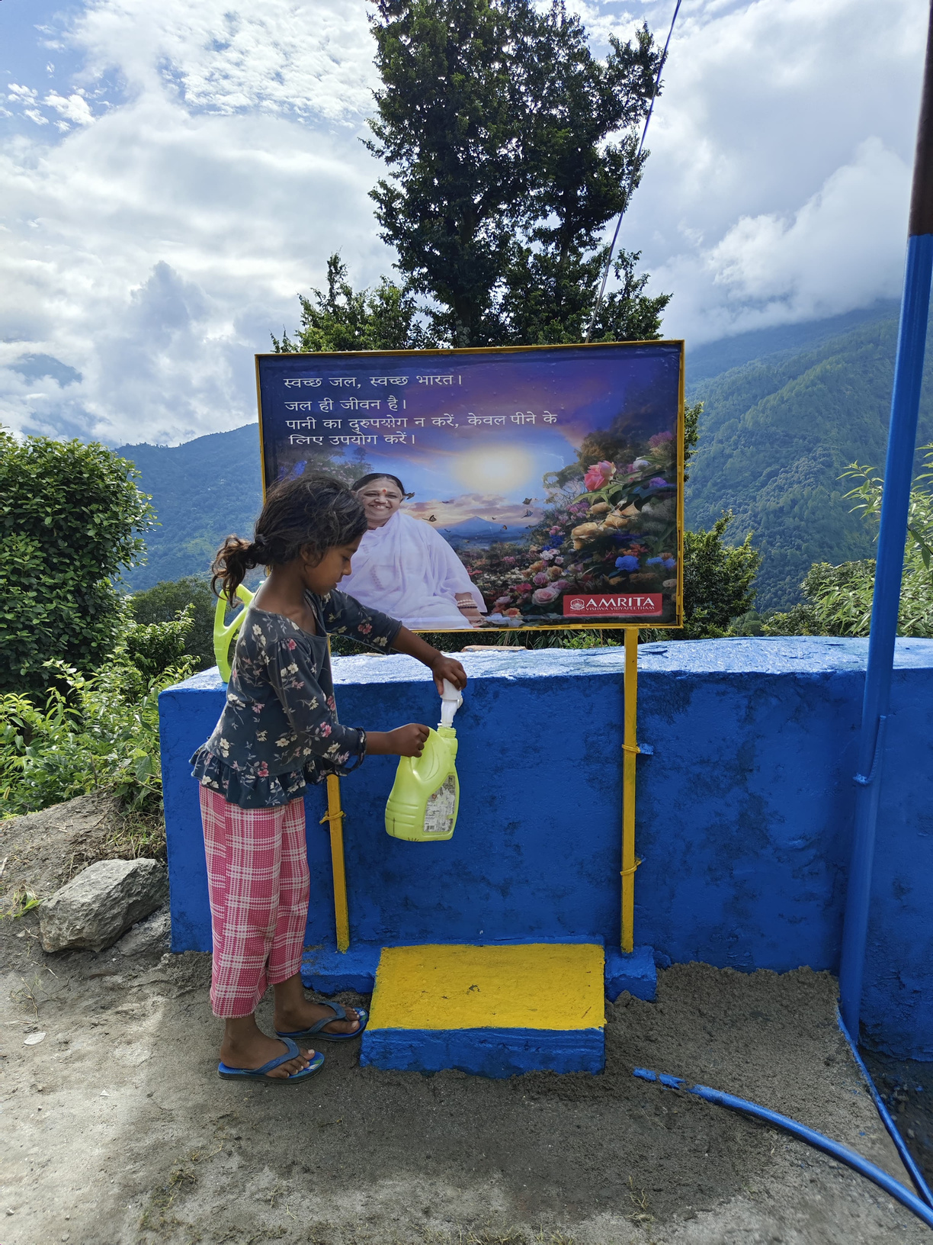
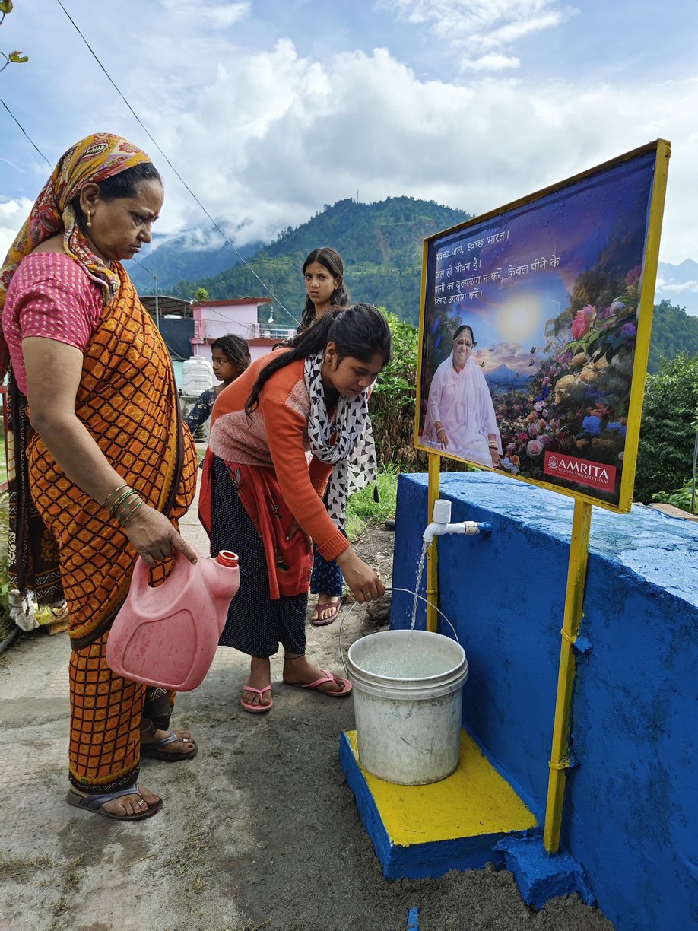
Implementation
Women collecting water
31
33

Slide 34
Project Outcomes
Safe Drinking Water for All:
The installed Jivamritham filtration unit now provides clean, odor-free, and biologically safe water to every household in the village.
Improved Hygiene & Reduced Effort:
The new system and nearby collection points have reduced the physical strain of fetching water from distant or unsafe sources. Distance reduced by 500 metres.
Follow-Up and Monitoring
Continuous contact is maintained with the village coordinator and temple priest to ensure the filtration system remains functional and well-maintained.
An agreement with the Panchayat ensures that the costs of filter maintenance and repair are handled locally, securing long-term sustainability.
34

Slide 35
Conclusion
The project enabled safe, reliable, and inclusive drinking water access for all households in Naala via a participatory approach.
The installed multistage filtration system with community management improved water safety, reduced disease risks, and addressed local social sensitivities.
Community ownership was enhanced by inclusive decision-making, awareness sessions, and hands on participation, ensuring sustainability.
35

Slide 36
Conclusion
Instead of imposing a solution, we worked hand-in-hand with the community using Human Centered Design tools from storytelling , sketching ,voting etc. This helped us design and implement a culturally sensitive, low maintenance Jivamritam filtration unit that the villagers could truly own and sustain.
Community ownership was enhanced by inclusive decision-making, awareness sessions, and hands-on participation, ensuring sustainability.
A regular cleaning schedule, continued community education, and monitoring of health outcomes.
36

